Slide 1
Overview of Seizures in Children
Dr. Bill Kigathi

Slide 2
Outline of Topics
Definition of Seizures
Evaluation of Seizures
Approach to Febrile Seizures
Approach to Children with recurrent seizures
Important Aspects of the history and examination of seizures
When to Refer

Slide 3
UNDERST ANDING SEIZURES:
BASIC DEFINITIONS

Slide 4
What is a seizure/convulsion?
A sudden stereotyped episode with change in motor activity, sensation, behavior, and/or consciousness due to an abnormal electrical discharge in the brain
The term convulsions is often used interchangeably with seizures.
Convulsions are a type of motor seizure, but not all seizures are convulsions.
Several types of seizures have symptoms other than shaking.

Slide 5
Symptoms of Seizures
Behavioral arrest
Changes in behavior including mood changes
Bitter /metallic taste
Purposeless movements such as picking at one’s clothes (automatisms)
Abnormal eye movements, eye deviation
Drooling, frothing at the mouth
Rhythmic twitching or jerking of limbs or face or the entire body
Staring
Eye lid fluttering
Sudden fall(s)
Loss of tone or stiffening of the extremities
Teeth clenching
Temporary stop in breathing

Slide 6
Seizures : Causes
Seizures can be:
Provoked : seizure with an acute antecedent cause, such as:
CNS infection (meningitis, encephalitis)
Trauma
Metabolic abnormality (abnormal levels of glucose, sodium)
Toxic exposure (drugs, alcohol)
Fever
Unprovoked seizure: no immediate provoking factor

Slide 7
Seizures : Causes
A cause is identifiable in < 20% of children with seizures.
Other causes of seizures include:
Brain malformations
Genetic disorders
Disorders of metabolism
Traumatic or previous infectious injury of the brain
Neoplasms
Neurodevelopmental abnormalities make it more likely a cause will be identified or may already have been determined before seizure onset.

Slide 8
FEBRILE SEIZURES

Slide 9
Febrile Seizures
A seizure that occurs in association with a fever (temperature at or above 100.4°F or 38°C by any method)
Very common in children (3-4%)
Age of onset - Age 6 months to 5 years (median age 18-22 months)
No evidence of a CNS infection, or acute neurologic illness
Usually occurs in an otherwise normal child
There may/may not be a family history of febrile seizures/epilepsy

Slide 10
Febrile Seizures - Classification
Simple febrile seizures are generalized tonic-clonic convulsions that last less than 15 minutes and do not recur within 24 hours.
Complex febrile seizures are less common and are focal or prolonged beyond 15 minutes or recur within 24 hours. These account for about 25% of febrile seizures.

Slide 11
Febrile Seizures - Classification
Triggered by any illness that causes fever, most frequently by otitis media and upper respiratory tract infections, gastroenteritis or other viral
A febrile seizure can be the first sign of a febrile illness and are thus diagnosed on exclusion of all other causes of seizures
1/3 of children who have a febrile seizure will have another one with another febrile illness.
The younger the child is at the time of the first episode, the greater the risk is of recurrence.
Approximately 50% of the recurrences occur within 6 months of the initial seizure; 75% occur within 1 year.

Slide 12
Febrile Seizures - Evaluation
Thorough history and examination - Aimed at determining the cause of fever
Diagnostic studies:
Tests that are considered include with the first febrile convulsion
Lumbar puncture!
EEG
Neuroimaging
Blood tests – FHG; UEC; CRP; Malaria Slide and Antigen Test; Calcium; Magnesium

Slide 13
Febrile Seizures – Clinical Practice Guidelines
Guideline for the Neurodiagnostic Evaluation of the Child With a Simple Febrile Seizure
A lumbar puncture (LP) should be performed in any child who presents with a seizure and a fever and has meningeal signs and symptoms (eg, neck stiffness, Kernig and/or Brudzinski signs) OR
Any child whose history or examination suggests the presence of meningitis or intracranial infection.

Slide 14
Febrile Seizures – Clinical Practice Guidelines
Guideline for the Neurodiagnostic Evaluation of the Child With a Simple Febrile Seizure
A lumbar puncture (LP) should be performed in any child who presents with a seizure and a fever and has meningeal signs and symptoms (eg, neck stiffness, Kernig and/or Brudzinski signs) OR
Any child whose history or examination suggests the presence of meningitis or intracranial infection.
A LP is an option in the child who presents with a seizure and fever and is pretreated with antibiotics, because antibiotic treatment can mask the signs and symptoms of meningitis.

Slide 15
Febrile Seizures – Clinical Practice Guidelines
Guideline for the Neurodiagnostic Evaluation of the Child With a Simple Febrile Seizure
An electroencephalogram (EEG)should not be performed in the evaluation of a neurologically healthy child with a simple febrile seizure.
Neuroimaging should not be performed in the routine evaluation of the child with a simple febrile seizure

Slide 16
Febrile Seizures – Prognosis
Prognosis: Excellent, except:
30-50% risk of recurrence
Double the risk of epilepsy, 1% - 2%

Slide 17
Febrile Seizures – Prognosis
Treatment of seizure
Often the seizure has stopped by the time the child is brought in for evaluation.
If the seizure continues - 1st ABCD Evaluation
Then lorazepam or diazepam should be administered.
Treatment of fever
The temperature should be brought down by using rectal antipyretics, removing blankets and clothing, and sponging.
Once the seizure is controlled, evaluation is directed toward finding the cause of the fever.

Slide 18
Febrile Seizures – Treatment
isk factors (after 1 simple febrile seizure):
Age <18 months
Family history of febrile seizures (1st degree relative)
Low degree of fever at the time of the seizure
Short duration of illness before occurrence of seizure
Overall Recurrence Risk = 32% over next 2 years.
Recurrence risk (based on above risk factors):
NO risk factors: 4%
1 risk factor: 23%
2 risk factors: 32%
3 risk factors: 62%
4 risk factors: 76%

Slide 19
EPILEPSY

Slide 20
Definition
Epilepsy is defined by the presence of 2 or more recurrent unprovoked seizures.
Lifetime prevalence of epilepsy to be 10.2/1000 or 1% (Russ et al, Pediatrics 2012).
Approximately 1 in 26 people will develop epilepsy at some
point in their lives.
Epilepsy affects an estimated 2.2 million people in the United States.

Slide 21
Epilepsy – Beyond the definition
Epilepsy is more than seizures, it is a complex disease associated with several neurological and psychiatric comorbidities:
Depression​
ADHD​
Anxiety​
Conduct problems (Russ et al, Pediatrics 2012)
Developmental delay
Autism/ Autism Spectrum disorde

Slide 22
Epilepsy – Beyond the definition
Epilepsy may occur as a result of an Epilepsy Syndrome
Clusters of signs and symptoms
Age of onset, severity
Diurnal or nocturnal occurrence
Clinical course
Associated neurologic dysfunction
Inheritance

Slide 23
Seizure Descriptions in Epilepsy
Seizures are classified with respect to where the abnormal neuronal activity occurs.
With generalized seizures, both hemispheres of the brain are involved and there is loss of consciousness.
Movements are tonic or clonic or a combination. Absence seizures are also generalized.
Partial seizures may be simple or complex, and involve only one hemisphere of the brain.
In complex partial seizures, there is altered level of consciousness, while in simple partial seizures there is NO loss of consciousness; however, there may be transient cognitive impairments.

Slide 24
Seizure Descriptions in Epilepsy
Movements can begin with a single muscle group and then spread in both complex and simple partial seizures.
The different types of symptoms that may occur include
motor symptoms such as - head/eye deviation, jerking, stiffening;
autonomic symptoms, such as - pupillary dilatation, drooling, pallor, change in heart rate or respiratory rate, as well as somatosensory symptoms, such as smells and/or alteration of perception (for example déjà vu).

Slide 25
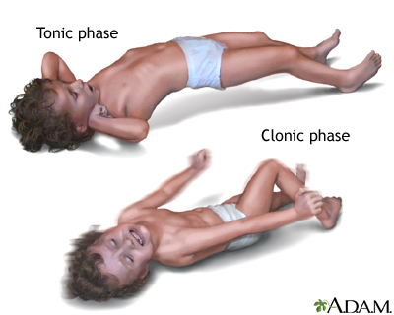
Generalized Seizure Classification: Descriptions¹
Tonic seizures are brief seizures (usually < 60 seconds) consisting of the sudden onset of increased tone in the extensor muscles
These seizures are invariably longer than myoclonic seizures. Occasionally tonic seizures terminate with a clonic phase.
During a clonic seizure, jerking of the body or parts of the body are the main symptom
Clonic seizure movements cannot be stopped by restraining the person.
Independent Clonic seizures are rare.
Notes:
This slide provides further descriptions of generalized seizures. Absence seizures are frequent, abrupt losses of consciousness that may be seen as staring or day-dreaming. Atonic are generalized seizures resulting in loss of muscle tone. Myoclonic are rapid, short contractions of one or all extremities.

Slide 26
Generalized Seizure Classification: Descriptions¹
Absence – Abrupt lapses of consciousness lasting a few seconds
Atonic – Abrupt, unexpected loss of muscle tone
Myoclonic – Rapid short contractions of one or all extremities
Notes:
This slide provides further descriptions of generalized seizures. Absence seizures are frequent, abrupt losses of consciousness that may be seen as staring or day-dreaming. Atonic are generalized seizures resulting in loss of muscle tone. Myoclonic are rapid, short contractions of one or all extremities.

Slide 27
Seizure Classifications
Generalized | Partial
 | Complex | Simple
Involves BOTH hemispheres of the brain | Involves motor* or autonomic# symptoms with altered level of consciousness | Can involve motor,* autonomic# or somatosensory⁺ symptoms
Always involves loss of consciousness | May start in one muscle group and spread | May start in one muscle group and spread
Types: Tonic or clonic movements or combination (grand mal) Absence (petit mal) Myoclonic Atonic (e.g., drop attacks) Infantile spasms
Types of symptoms:
1) Motor* - head/eye deviation, jerking, stiffening
2) Autonomic# - pupillary dilatation, drooling, pallor, change in
heart rate or respiratory rate
3) Somatosensory⁺ - smells, alteration of perception (déjà vu)
Notes:
Seizures are classified with respect to where the abnormal neuronal activity occurs. With generalized seizures, both hemispheres of the brain are involved and there is loss of consciousness. Movements are tonic or clonic or a combination. Absence seizures are also generalized. Partial seizures may be simple or complex, and involve only one hemisphere of the brain. In complex partial seizures, there is altered level of consciousness, while in simple partial seizures there is NO loss of consciousness; however, there may be transient cognitive impairments. Movements begin with a single muscle group and then spread in both complex and simple partial seizures. The different types of symptoms that may occur include motor symptoms such as - head/eye deviation, jerking, stiffening; autonomic symptoms, such as - pupillary dilatation, drooling, pallor, change in heart rate or respiratory rate, as well as somatosensory symptoms, such as smells and/or alteration of perception (for example déjà vu).

Slide 28


Classification of Seizures
Epilepsy Syndromes
and
Generalized seizures
Focal Seizures
• Simple partial *
• Complex partial *
• Partial seizures with secondary
generalization *
•
•
•
•
Absence
Myoclonic
Atonic, astatic
Tonic-clonic
Generalized Epilepsy
Syndromes
Focal Epilepsy Syndromes
•
Benign epilepsy of childhood with
centrotemporal spikes (BECTS)
Benign occipital epilepsy
Focal epilepsy with mesial temporal
sclerosis
•
•
•
•
Childhood absence epilepsy
Juvenile myoclonic epilepsy
Infantile spasms (West syndrome)
Lennox-Gastaut syndrome
•
•
* Terminology from old classification

Slide 29
Important Aspects of the History and Exam
Primary care physician is usually the first point of contact after a child has a seizure
If the patient is not actively seizing at the time of evaluation
Obtain a clear history of the event, preferably in person and from a witness, so as to be able to distinguish the event from other nonepileptic events

Slide 30
Important Aspects of the History and Exam
Past and Recent Medical History
Known risk factors
Pre/peri/post-natal complications
Head trauma
CNS infections
Febrile Seizures
Other medical conditions
Recent symptoms (illness, head injury, lack of sleep, dehydration)
Developmental history
Medications/toxin exposures (EtOH, illicits, Rx meds, etc.)
Family history
Febrile seizures or epilepsy, 1st and 2nd degree relatives

Slide 31
Important Aspects of the History and Exam
Context of event(s)
Circumstances under which the events occur
Timing and circadian distribution
Position (lying, sitting, standing, transitions)
Associated activities at the time of the event (at rest, during exercise)
Triggering factors (crying, fever, etc)
Facilitating factors (dehydration, illness, alcohol/illicit drug /consumption, sleep deprivation)
Detailed description of all event(s)
Was the onset witnessed?
Description from start to end, including the aura and postictal effects, until recovery to normal.

Slide 32
Important Aspects of the History and Exam
Difficulty in diagnosis and potential misdiagnosis can result from failure to obtain a detailed description of the event
Not enough time to spend taking detailed history
Inexact historian
Witness not available
Onset not witnessed
Importance of documentation of detailed history to help facilitate care coordination between primary care and specialists.

Slide 33
Important Aspects of the History and Exam
Convulsions specific history:
Was there a warning right before the convulsion (behavioral arrest, affective change)?
Did the head/eyes deviate upward or to one side?
Did the movements start unilaterally or bilaterally?
How did the seizure progress?
How long did the seizure last?
What was the child like immediately after and how long to recover to baseline?

Slide 34
Important Aspects of the History and Exam
Staring specific history
Spells noted in multiple environments (absence)
Spells interrupt activities (absence) or have postictal manifestations (focal)
Spells don’t stop with physical touch
Spells precipitated by hyperventilation during exam?

Slide 35
Important Aspects of the History and Exam
Neurological Exam
A screening neurologic exam is most appropriate, assessing for multiple signs indicative of neurologic injury.
Cranial nerves: Pupil reactivity, nystagmus, facial symmetry/strength, palate elevation, tongue protrusion.
Motor: muscle bulk, tone, and strength (assess for asymmetries), reflexes, Babinski response
Coordination: finger to nose movements (assess for focal tremors)
Gait: Look for ataxia, circumduction.

Slide 36
Important Aspects of the History and Exam
Condition Specific Assessment
CNS infection
Fever, headache, prolonged seizure, prolonged postictal state
Stiff neck, confusion
Head trauma
History, external evidence, focal deficit
Brain tumor
Headache, focal seizure, focal deficits

Slide 37
Important Aspects of the History and Exam
Condition Specific Assessment
Genetic syndromes and brain malformations
Developmental delay, Dysmorphism
Cerebral hemorrhage
Trauma, family history of cerebral cavernous malformations, focal seizures, focal deficits
Neurocutaneous disorders
Birthmarks (hypopigmented macules, café au lait spots etc)

Slide 38
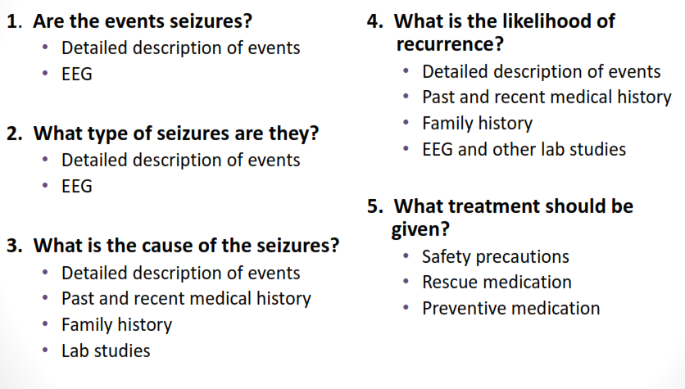
Important Aspects of the History and Exam

Slide 39
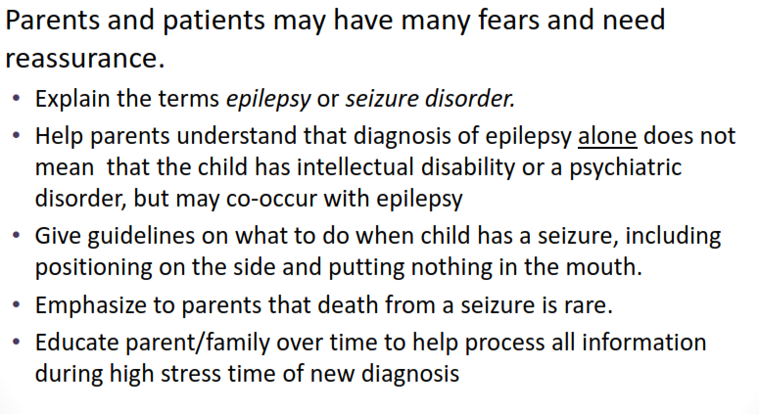
Addressing Parents After a Seizure

Slide 40
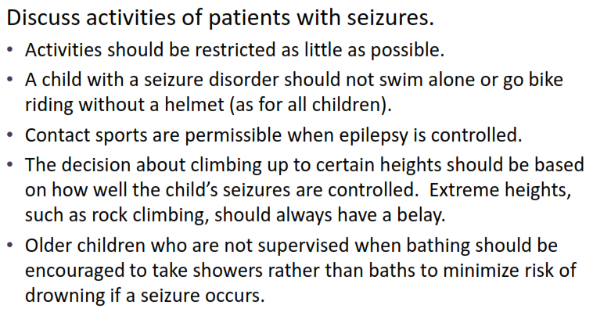
Addressing Parents After a Seizure

Slide 41
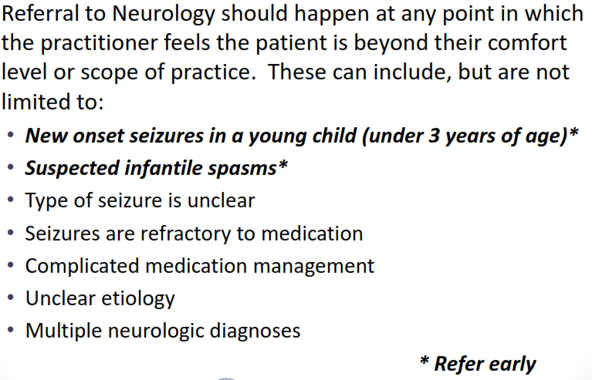
Referral of Patients After a Seizure

Slide 42
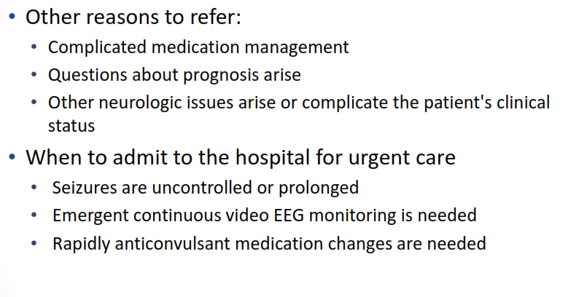
Referral of Patients After a Seizure

Slide 43
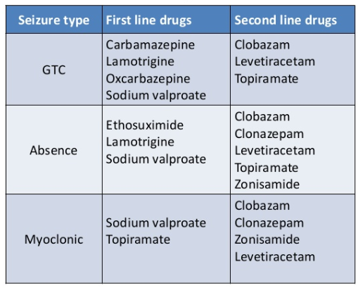
Treatment
Uncomplicated Epilepsy is treated with 1st line and 2nd line medications
1st line doses must be optimized before switching to second line medications

Slide 44
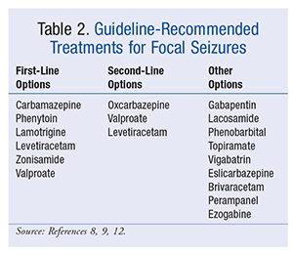
Treating focal seizures

Slide 45
Questions and the End!!!

